Slide 1
Module 4
Number Pairs, Addition and
Subtraction to 10
(Lessons 25-41)

Slide 2
Lesson Links Click on the lesson you want to go to! (You must be in Slide Show/Presentation Mode.)
Lesson 25 Lesson 31 Lesson 37 Lesson 26 Lesson 32 Lesson 38 Lesson 27 Lesson 33 Lesson 39 Lesson 28 Lesson 34 Lesson 40 Lesson 29 Lesson 35 Lesson 41 Lesson 30 Lesson 36

Slide 3
Lesson 25
I can break apart 9.

Slide 4
Module 4, Lesson 25
Fluency
Rekenrek Wave
You’ve become very good at counting with the Rekenrek the Say Ten Way. I want to teach you the regular way to say the numbers that come after 10. Here is 10.

Slide 5
Module 4, Lesson 25
Fluency
Rekenrek Wave
1 more than 10 is 11. Say “eleven.”
How many beads do you see?

Slide 6
Module 4, Lesson 25
Fluency
Rekenrek Wave
1 more than 11 is 12. Say “twelve.”
How many beads do you see?

Slide 7
Module 4, Lesson 25
Fluency
Rekenrek Wave
1 more than 12 is 13. Say “thirteen.”
How many beads do you see?

Slide 8
Module 4, Lesson 25
Fluency
Rekenrek Wave
Now, gradually raise your hands as the numbers increase and lower your hands as the numbers decrease, like the motion of a wave!

Slide 9
Module 4, Lesson 25
Fluency
Rekenrek Wave
Now, gradually raise your hands as the numbers increase and lower your hands as the numbers decrease, like the motion of a wave!

Slide 10
Module 4, Lesson 25
Fluency
Rekenrek Wave
Now, gradually raise your hands as the numbers increase and lower your hands as the numbers decrease, like the motion of a wave!

Slide 11
Module 4, Lesson 25
Fluency
Rekenrek Wave
Now, gradually raise your hands as the numbers increase and lower your hands as the numbers decrease, like the motion of a wave!

Slide 12
Module 4, Lesson 25
Fluency
Rekenrek Wave
Now, gradually raise your hands as the numbers increase and lower your hands as the numbers decrease, like the motion of a wave!

Slide 13
Module 4, Lesson 25
Fluency
Rekenrek Wave
Now, gradually raise your hands as the numbers increase and lower your hands as the numbers decrease, like the motion of a wave!

Slide 14
Module 4, Lesson 25
Fluency
Rekenrek Wave
Now, gradually raise your hands as the numbers increase and lower your hands as the numbers decrease, like the motion of a wave!

Slide 15
Module 4, Lesson 25
Fluency
Rekenrek Wave
Now, gradually raise your hands as the numbers increase and lower your hands as the numbers decrease, like the motion of a wave!

Slide 16
Module 4, Lesson 25
Fluency
Rekenrek Wave
Now, gradually raise your hands as the numbers increase and lower your hands as the numbers decrease, like the motion of a wave!

Slide 17
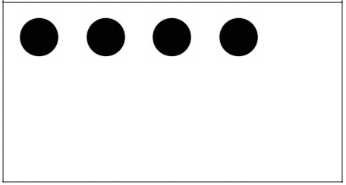
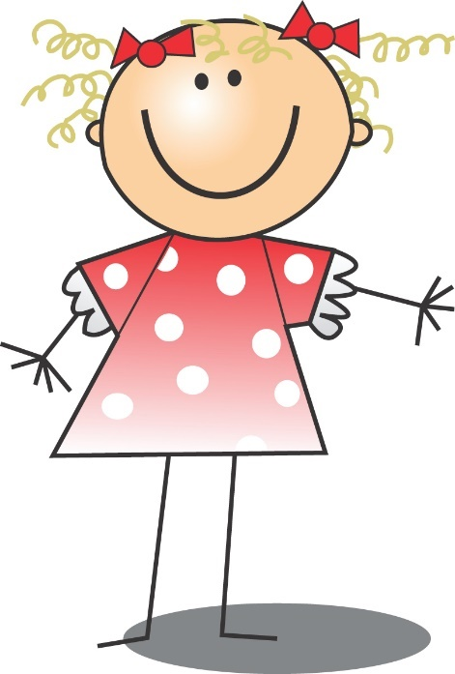
Module 4, Lesson 25
Fluency
5-Group Flashes
How many dots do you see? How many more to make 5? Say the number sentence. Write the number sentence on your board. Get ready. Show me.

Slide 18
Module 4, Lesson 25
Fluency
5-Group Flashes
How many dots do you see? How many more to make 5? Say the number sentence. Write the number sentence on your board. Get ready. Show me.

Slide 19
Module 4, Lesson 25
Fluency
5-Group Flashes
How many dots do you see? How many more to make 5? Say the number sentence. Write the number sentence on your board. Get ready. Show me.

Slide 20
Module 4, Lesson 25
Fluency
5-Group Flashes
How many dots do you see? How many more to make 5? Say the number sentence. Write the number sentence on your board. Get ready. Show me.

Slide 21
Module 4, Lesson 25
Fluency
5-Group Flashes
How many dots do you see? How many more to make 5? Say the number sentence. Write the number sentence on your board. Get ready. Show me.

Slide 22
Module 4, Lesson 25
Fluency
5-Group Flashes
How many dots do you see? How many more to make 5? Say the number sentence. Write the number sentence on your board. Get ready. Show me.

Slide 23
Module 4, Lesson 25
Fluency
5-Group Flashes
How many dots do you see? How many more to make 5? Say the number sentence. Write the number sentence on your board. Get ready. Show me.

Slide 24
Module 4, Lesson 25
Fluency
5-Group Flashes
How many dots do you see? How many more to make 5? Say the number sentence. Write the number sentence on your board. Get ready. Show me.

Slide 25
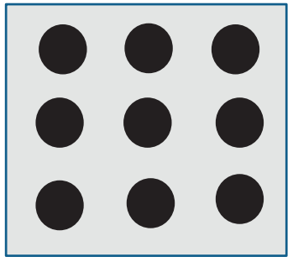
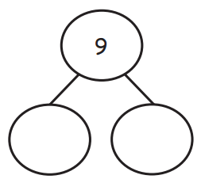
Module 4, Lesson 25
Fluency
Take Apart the Array
Let’s count the dots. Ready? Our job is to take apart…? We can break apart the 9 dots by drawing a straight line like this (click). How many dots are in the top part? The other part? (Complete the number bond.) We can read it like this: 9 is 3 and 6. Echo me, please.

Slide 26
Module 4, Lesson 25
Fluency
Take Apart the Array
We can also take apart the 9 dots with a line that looks like an L (click). How many dots are in the smaller part? The other part? (Complete the number bond.) We can read it like this: 9 is 2 and 7. Echo me, please.

Slide 27
Module 4, Lesson 25
Fluency
Take Apart the Array
Now, it’s your turn to find some ways to take apart 9!
Be ready to share!

Slide 28
Application Problem
Module 4, Lesson 25
There were 9 flowers in Casey’s beautiful garden. She had 2 vases. Draw 1 way she could have put all of the flowers into the vases. Show your picture to your partner. Did he draw the flowers in the vases the same way? Are both ways right? Are there other ways you could have shown the flowers?

Slide 29
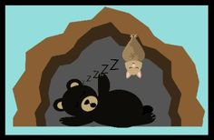
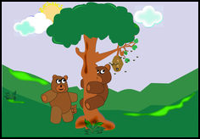
Module 4, Lesson 25
There were 9 bears in the forest. Some bears went to
sleep in their caves, and some left to find a honey tree.
Use your counters to show the bears.
Help me finish the story and make a number bond!

Slide 30
Module 4, Lesson 25
There were 9 bears in the forest. Some bears went to
sleep in their caves, and some left to find a honey tree.
Use your counters to show the bears.
Can you think of another
way to finish the story?

Slide 31
Module 4, Lesson 25
Let’s play a game!
While your partner closes their eyes, hide some of your bears under the bowl to show the sleepy bears in the cave.
Tell your partner to open their eyes. How many bears are outside? Can they figure out how many are in the cave?
Draw a number bond, then switch! How many partners for 9 can you find?

Slide 33
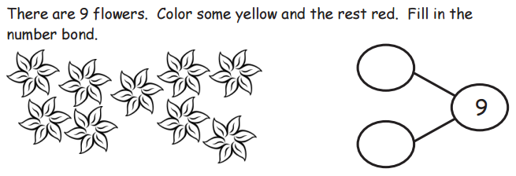

Slide 34
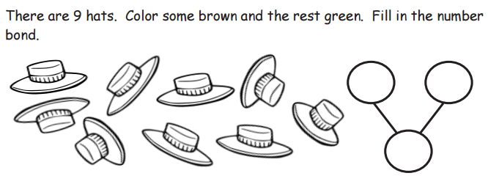

Slide 35
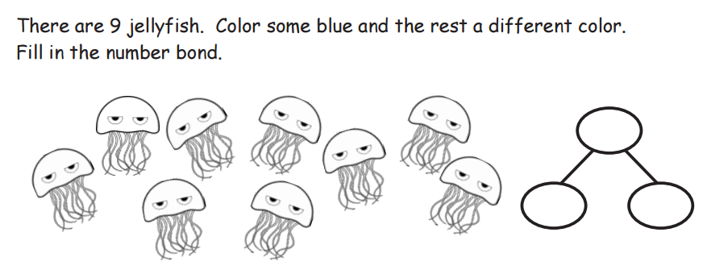

Slide 36
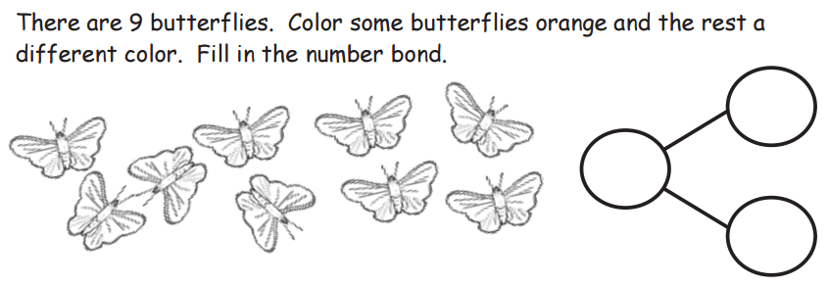

Slide 37
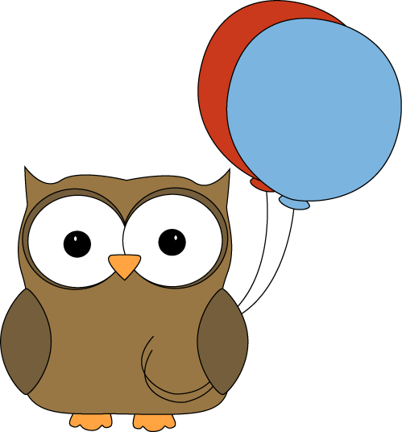

Slide 38
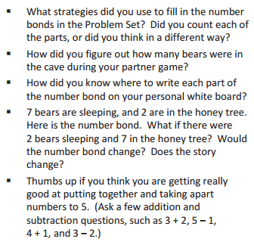
Debrief

Slide 39
Lesson 26
I can model how to break apart 9 using fingers, linking cubes, and number bonds.

Slide 40
Module 4, Lesson 26
Fluency
Rekenrek Wave
Let’s review the regular way to say the numbers that come after 10. Then, we’ll learn some new ones! Here is 10.

Slide 41
Module 4, Lesson 26
Fluency
Rekenrek Wave
1 more than 10 is 11. Say “eleven.”
How many beads do you see?

Slide 42
Module 4, Lesson 26
Fluency
Rekenrek Wave
1 more than 11 is 12. Say “twelve.”
How many beads do you see?

Slide 43
Module 4, Lesson 26
Fluency
Rekenrek Wave
1 more than 12 is 13. Say “thirteen.”
How many beads do you see?

Slide 44
Module 4, Lesson 26
Fluency
Rekenrek Wave
1 more than 13 is 14. Say “fourteen.”
How many beads do you see?

Slide 45
Module 4, Lesson 26
Fluency
Rekenrek Wave
1 more than 14 is 15. Say “fifteen.”
How many beads do you see?

Slide 46
Module 4, Lesson 26
Fluency
Rekenrek Wave
Now, gradually raise your hands as the numbers increase and lower your hands as the numbers decrease, like the motion of a wave!

Slide 47
Module 4, Lesson 26
Fluency
Rekenrek Wave
Now, gradually raise your hands as the numbers increase and lower your hands as the numbers decrease, like the motion of a wave!

Slide 48
Module 4, Lesson 26
Fluency
Rekenrek Wave
Now, gradually raise your hands as the numbers increase and lower your hands as the numbers decrease, like the motion of a wave!

Slide 49
Module 4, Lesson 26
Fluency
Rekenrek Wave
Now, gradually raise your hands as the numbers increase and lower your hands as the numbers decrease, like the motion of a wave!

Slide 50
Module 4, Lesson 26
Fluency
Rekenrek Wave
Now, gradually raise your hands as the numbers increase and lower your hands as the numbers decrease, like the motion of a wave!

Slide 51
Module 4, Lesson 26
Fluency
Rekenrek Wave
Now, gradually raise your hands as the numbers increase and lower your hands as the numbers decrease, like the motion of a wave!

Slide 52
Module 4, Lesson 26
Fluency
Rekenrek Wave
Now, gradually raise your hands as the numbers increase and lower your hands as the numbers decrease, like the motion of a wave!

Slide 53
Module 4, Lesson 26
Fluency
Rekenrek Wave
Now, gradually raise your hands as the numbers increase and lower your hands as the numbers decrease, like the motion of a wave!

Slide 54
Module 4, Lesson 26
Fluency
Rekenrek Wave
Now, gradually raise your hands as the numbers increase and lower your hands as the numbers decrease, like the motion of a wave!

Slide 55
Module 4, Lesson 26
Fluency
Rekenrek Wave
Now, gradually raise your hands as the numbers increase and lower your hands as the numbers decrease, like the motion of a wave!

Slide 56
Module 4, Lesson 26
Fluency
Rekenrek Wave
Now, gradually raise your hands as the numbers increase and lower your hands as the numbers decrease, like the motion of a wave!

Slide 57
Module 4, Lesson 26
Fluency
Rekenrek Wave
Now, gradually raise your hands as the numbers increase and lower your hands as the numbers decrease, like the motion of a wave!

Slide 58
Module 4, Lesson 26
Fluency
Rekenrek Wave
Now, gradually raise your hands as the numbers increase and lower your hands as the numbers decrease, like the motion of a wave!

Slide 59
Module 4, Lesson 26
Fluency
Race to 5 Addition Game
Each partner rolls their die and says their number. Both partners roll again and add the previous number to the new number on the die. Both partners state their new equations. Continue the addition race, rolling the dice and adding with speed and accuracy until one of the partners reaches 5 as the total. He must reach 5 exactly, so if either partner reaches a total more than 5, he can roll again.

Slide 60
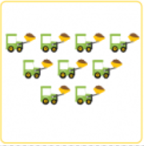
Module 4, Lesson 26
Fluency
Make 9 Matching Game
Work with your partner. Shuffle and place the cards facedown in two equal rows. Partner A turns over two cards. If the total of the numbers on the two cards make 9, then she collects both cards. If not, then Partner A turns them back over in their original place. Repeat for Partner B.

Slide 61
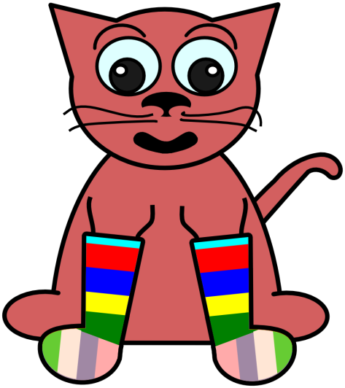
Application Problem
Module 4, Lesson 26
It is laundry day. We have 9 extra socks! Some are green and the rest are blue. Draw the set of green socks and the set of blue socks. Make a number bond to help tell about your picture.
Turn and talk to your partner about your drawings and number bonds. Do they look alike? Are your sets of socks different?
Turn your paper over and show the story a different way.

Slide 62
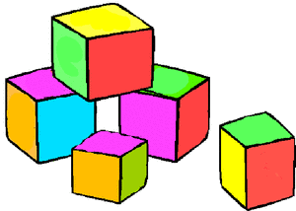
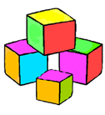
Module 4, Lesson 26
Lee had 9 blocks. Hold up 9 fingers to show how many blocks she had. Show me the Math Way! 5 of her blocks were red, and the rest were blue. Show me her red blocks with your fingers. How many? Show me her blue blocks. How did you know? Draw a number bond!

Slide 63
Module 4, Lesson 26
Take out your linking cubes and put them in a stick. Use you
blue cubes first. How many cubes are in your stick?

Slide 64
Module 4, Lesson 26
Take off 1 red cube. Do you still have 9 cubes in all?
What are the parts now? Draw the number bond.

Slide 65
Module 4, Lesson 26
Take another cube off your long stick, and put it
together with the 1 cube. Do we still have 9 cubes?
What are our new parts? Draw the number bond!

Slide 66
Module 4, Lesson 26
Take another cube off your long stick, and put it
together with the 2 cubes. Do we still have 9 cubes?
What are our new parts? Draw the number bond!

Slide 67
Module 4, Lesson 26
Take another cube off your long stick, and put it
together with the 3 cubes. Do we still have 9 cubes?
What are our new parts? Draw the number bond!

Slide 68
Module 4, Lesson 26
Take another cube off your long stick, and put it
together with the 4 cubes. Do we still have 9 cubes?
What are our new parts? Draw the number bond!

Slide 69
Module 4, Lesson 26
Take another cube off your long stick, and put it
together with the 5 cubes. Do we still have 9 cubes?
What are our new parts? Draw the number bond!

Slide 70
Module 4, Lesson 26
Take another cube off your long stick, and put it
together with the 6 cubes. Do we still have 9 cubes?
What are our new parts? Draw the number bond!

Slide 71
Module 4, Lesson 26
Take another cube off your long stick, and put it
together with the 7 cubes. Do we still have 9 cubes?
What are our new parts? Draw the number bond!

Slide 72
Module 4, Lesson 26
Put your 9-sticks back together again.
Work with your friend to find hidden partner inside 9.
Could you think of a story to tell about the cubes?
Be sure to write each set of partners in number bonds!

Slide 73
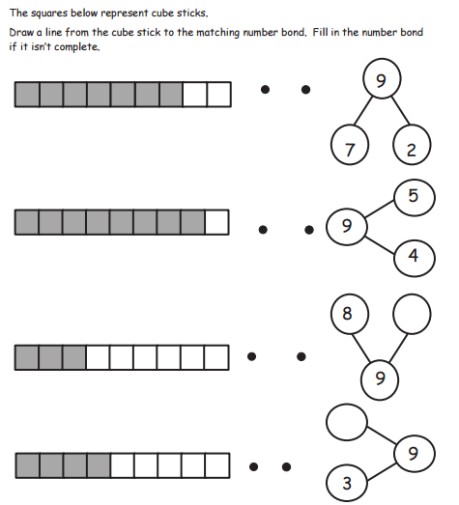

Slide 74
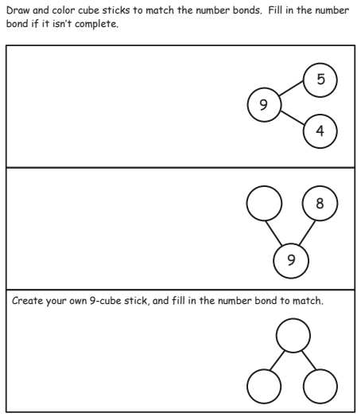

Slide 75
Debrief

Slide 76
Lesson 27
I can use number bonds to show composition stories.

Slide 77
Module 4, Lesson 27
Fluency
Rekenrek Wave
Let’s review the regular way to say the numbers that come after 10. Then, we’ll learn some new ones! Here is 10.

Slide 78
Module 4, Lesson 27
Fluency
Rekenrek Wave
1 more than 10 is 11. Say “eleven.”
How many beads do you see?

Slide 79
Module 4, Lesson 27
Fluency
Rekenrek Wave
1 more than 11 is 12. Say “twelve.”
How many beads do you see?

Slide 80
Module 4, Lesson 27
Fluency
Rekenrek Wave
1 more than 12 is 13. Say “thirteen.”
How many beads do you see?

Slide 81
Module 4, Lesson 27
Fluency
Rekenrek Wave
1 more than 13 is 14. Say “fourteen.”
How many beads do you see?

Slide 82
Module 4, Lesson 27
Fluency
Rekenrek Wave
1 more than 14 is 15. Say “fifteen.”
How many beads do you see?

Slide 83
Module 4, Lesson 27
Fluency
Rekenrek Wave
1 more than 15 is 16. Say “sixteen.”
How many beads do you see?

Slide 84
Module 4, Lesson 27
Fluency
Rekenrek Wave
1 more than 16 is 17. Say “seventeen.”
How many beads do you see?

Slide 85
Module 4, Lesson 27
Fluency
Rekenrek Wave
1 more than 17 is 18. Say “eighteen.”
How many beads do you see?

Slide 86
Module 4, Lesson 27
Fluency
Rekenrek Wave
1 more than 18 is 19. Say “nineteen.”
How many beads do you see?

Slide 87
Module 4, Lesson 27
Fluency
Rekenrek Wave
1 more than 19 is 20. Say “twenty.”
How many beads do you see?

Slide 88
Module 4, Lesson 27
Fluency
Rekenrek Wave
Now, gradually raise your hands as the numbers increase and lower your hands as the numbers decrease, like the motion of a wave!

Slide 89
Module 4, Lesson 27
Fluency
Rekenrek Wave
Now, gradually raise your hands as the numbers increase and lower your hands as the numbers decrease, like the motion of a wave!

Slide 90
Module 4, Lesson 27
Fluency
Rekenrek Wave
Now, gradually raise your hands as the numbers increase and lower your hands as the numbers decrease, like the motion of a wave!

Slide 91
Module 4, Lesson 27
Fluency
Rekenrek Wave
Now, gradually raise your hands as the numbers increase and lower your hands as the numbers decrease, like the motion of a wave!

Slide 92
Module 4, Lesson 27
Fluency
Rekenrek Wave
Now, gradually raise your hands as the numbers increase and lower your hands as the numbers decrease, like the motion of a wave!

Slide 93
Module 4, Lesson 27
Fluency
Rekenrek Wave
Now, gradually raise your hands as the numbers increase and lower your hands as the numbers decrease, like the motion of a wave!

Slide 94
Module 4, Lesson 27
Fluency
Rekenrek Wave
Now, gradually raise your hands as the numbers increase and lower your hands as the numbers decrease, like the motion of a wave!

Slide 95
Module 4, Lesson 27
Fluency
Rekenrek Wave
Now, gradually raise your hands as the numbers increase and lower your hands as the numbers decrease, like the motion of a wave!

Slide 96
Module 4, Lesson 27
Fluency
Rekenrek Wave
Now, gradually raise your hands as the numbers increase and lower your hands as the numbers decrease, like the motion of a wave!

Slide 97
Module 4, Lesson 27
Fluency
Rekenrek Wave
Now, gradually raise your hands as the numbers increase and lower your hands as the numbers decrease, like the motion of a wave!

Slide 98
Module 4, Lesson 27
Fluency
Rekenrek Wave
Now, gradually raise your hands as the numbers increase and lower your hands as the numbers decrease, like the motion of a wave!

Slide 99
Module 4, Lesson 27
Fluency
Rekenrek Wave
Now, gradually raise your hands as the numbers increase and lower your hands as the numbers decrease, like the motion of a wave!

Slide 100
Module 4, Lesson 27
Fluency
Rekenrek Wave
Now, gradually raise your hands as the numbers increase and lower your hands as the numbers decrease, like the motion of a wave!

Slide 101
Module 4, Lesson 27
Fluency
Rekenrek Wave
Now, gradually raise your hands as the numbers increase and lower your hands as the numbers decrease, like the motion of a wave!

Slide 102
Module 4, Lesson 27
Fluency
Rekenrek Wave
Now, gradually raise your hands as the numbers increase and lower your hands as the numbers decrease, like the motion of a wave!

Slide 103
Module 4, Lesson 27
Fluency
Rekenrek Wave
Now, gradually raise your hands as the numbers increase and lower your hands as the numbers decrease, like the motion of a wave!

Slide 104
Module 4, Lesson 27
Fluency
Rekenrek Wave
Now, gradually raise your hands as the numbers increase and lower your hands as the numbers decrease, like the motion of a wave!

Slide 105
Module 4, Lesson 27
Fluency
Rekenrek Wave
Now, gradually raise your hands as the numbers increase and lower your hands as the numbers decrease, like the motion of a wave!

Slide 106
Module 4, Lesson 27
Fluency
Rekenrek Wave
Now, gradually raise your hands as the numbers increase and lower your hands as the numbers decrease, like the motion of a wave!

Slide 107
Module 4, Lesson 27
Fluency
Rekenrek Wave
Now, gradually raise your hands as the numbers increase and lower your hands as the numbers decrease, like the motion of a wave!

Slide 108
Module 4, Lesson 27
Fluency
Rekenrek Wave
Now, gradually raise your hands as the numbers increase and lower your hands as the numbers decrease, like the motion of a wave!

Slide 109
Module 4, Lesson 27
Fluency
Rekenrek Wave
Now, gradually raise your hands as the numbers increase and lower your hands as the numbers decrease, like the motion of a wave!

Slide 110
Module 4, Lesson 27
Fluency
Rekenrek Wave
Now, gradually raise your hands as the numbers increase and lower your hands as the numbers decrease, like the motion of a wave!

Slide 111
Module 4, Lesson 27
Fluency
Rekenrek Wave
Now, gradually raise your hands as the numbers increase and lower your hands as the numbers decrease, like the motion of a wave!

Slide 112
Module 4, Lesson 27
Fluency
Rekenrek Wave
Now, gradually raise your hands as the numbers increase and lower your hands as the numbers decrease, like the motion of a wave!

Slide 113
Module 4, Lesson 27
Fluency
Rekenrek Wave
Now, gradually raise your hands as the numbers increase and lower your hands as the numbers decrease, like the motion of a wave!

Slide 114
Module 4, Lesson 27
Fluency
Rekenrek Wave
Now, gradually raise your hands as the numbers increase and lower your hands as the numbers decrease, like the motion of a wave!

Slide 115
Module 4, Lesson 27
Fluency
Rekenrek Wave
Now, gradually raise your hands as the numbers increase and lower your hands as the numbers decrease, like the motion of a wave!

Slide 116
Module 4, Lesson 27
Fluency
Rekenrek Wave
Now, gradually raise your hands as the numbers increase and lower your hands as the numbers decrease, like the motion of a wave!

Slide 117
Module 4, Lesson 27
Fluency
Rekenrek Wave
Now, gradually raise your hands as the numbers increase and lower your hands as the numbers decrease, like the motion of a wave!

Slide 118
Module 4, Lesson 27
Fluency
Rekenrek Wave
Now, gradually raise your hands as the numbers increase and lower your hands as the numbers decrease, like the motion of a wave!

Slide 119
Module 4, Lesson 27
Fluency
What is Less?
Think of a number that is less than 2. Write it on your personal white board, and show me. Write this subtraction sentence on your board: 2 minus 1. Write the answer and show me. Say the subtraction sentence.
2

Slide 120
Module 4, Lesson 27
Fluency
What is Less?
Think of a number that is less than 3. Write it on your personal white board, and show me. Write this subtraction sentence on your board: 3 minus 1. Write the answer and show me. Say the subtraction sentence. (Repeat with 3 minus 2.)
3

Slide 121
Module 4, Lesson 27
Fluency
What is Less?
Think of a number that is less than 4. Write it on your personal white board, and show me. Write this subtraction sentence on your board: 4 minus 1. Write the answer and show me. Say the subtraction sentence. (Repeat with 4 minus 2, 3.)
4

Slide 122
Module 4, Lesson 27
Fluency
What is Less?
Think of a number that is less than 5. Write it on your personal white board, and show me. Write this subtraction sentence on your board: 5 minus 1. Write the answer and show me. Say the subtraction sentence. (Repeat with 5 minus 2, 3, 4.)
5

Slide 123
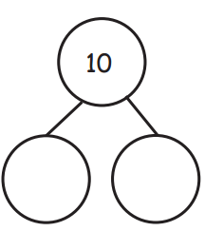
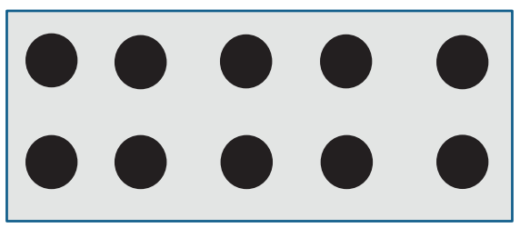
Module 4, Lesson 27
Fluency
Take Apart the Array
Let’s count the dots. Ready? Our job is to take apart…? We can break apart the 10 dots by drawing a straight line like this (click). How many dots are in the top part? The other part? (Complete the number bond.) We can read it like this: 10 is 2 and 8. Echo me, please.

Slide 124
Module 4, Lesson 27
Fluency
Take Apart the Array
We can also take apart the 10 dots with a line that looks like an L (click) How many dots are in the smaller part? The other part? (Complete the number bond.) We can read it like this: 10 is 3 and 7. Echo me, please.

Slide 125
Module 4, Lesson 27
Fluency
Take Apart the Array
Now, it’s your turn to find some ways to take apart 10!
Be ready to share!

Slide 126
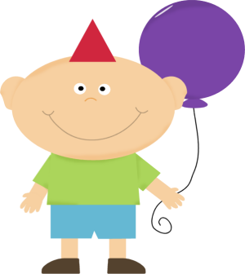
Application Problem
Module 4, Lesson 27
You are having a birthday party! You need 10 party hats for your friends. Draw 10 simple hats. Color some hats red and some hats blue. Make a number bond about your picture.
Turn and talk to your partner. Do your pictures look the same? Explain to your partner how you decided which way to color your hats. Talk about how your number bonds are the same or different.

Slide 127
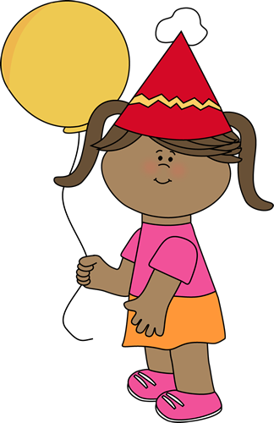
Module 4, Lesson 27
What if you had a birthday party and received 10 presents?
I’m going to draw squares to represent your presents. I want
to color some red and some yellow. Who has an idea?

Slide 128
Module 4, Lesson 27
Did anyone think about the picture in a different way?

Slide 129
Module 4, Lesson 27
10 is a very special number. What’s different about this number compared to the other ones we have looked at so far?

Slide 130
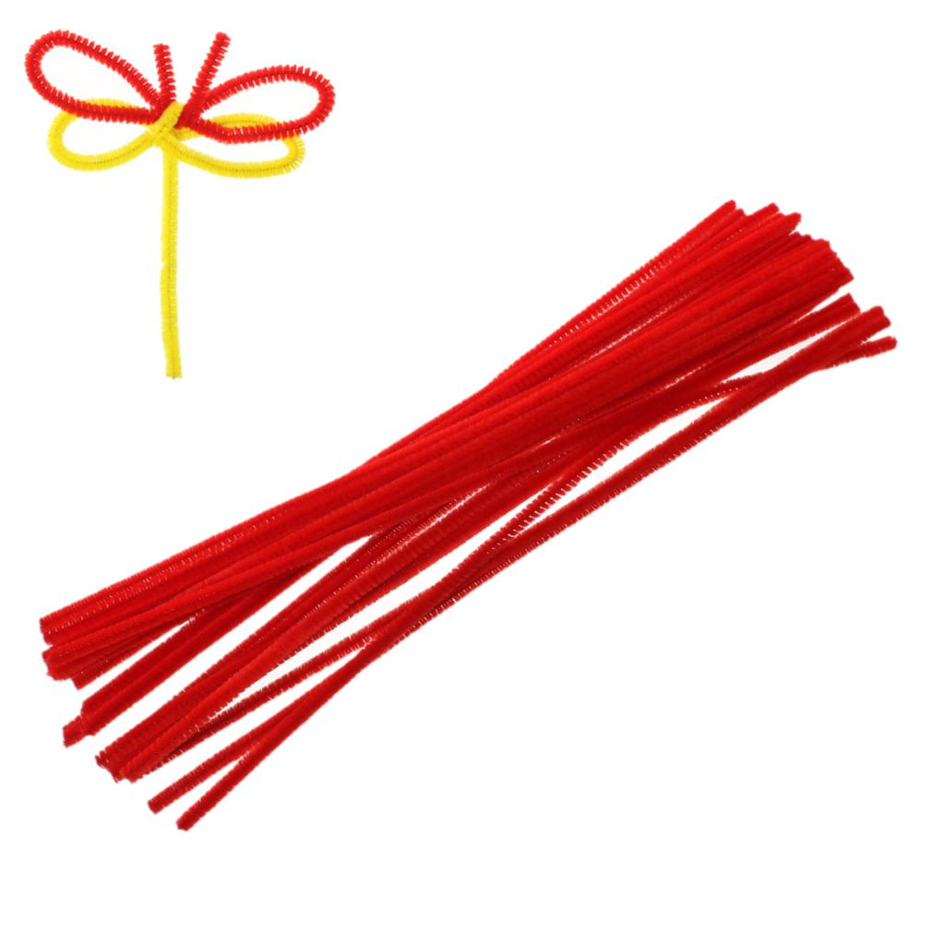
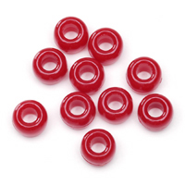
Module 4, Lesson 27
We’re going to make bracelets to celebrate this very special
number! Count your beads again while you string them on
your pipe cleaner. I’ll come around to help you finish it.
You have a pipe cleaner and some beads on your table.
Count the beads.

Slide 131
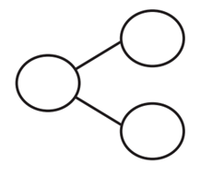
Module 4, Lesson 27
Let’s play with our beautiful bracelets! What happens if we slide 1 bead to one side and all the other beads to the other side of the bracelet? Show me! Let’s make a number bond!

Slide 132
Module 4, Lesson 27
What if we slid over 1 more bead?

Slide 133
Module 4, Lesson 27
Slide over another!

Slide 134
Module 4, Lesson 27
Another!

Slide 135
Module 4, Lesson 27
And another!

Slide 136
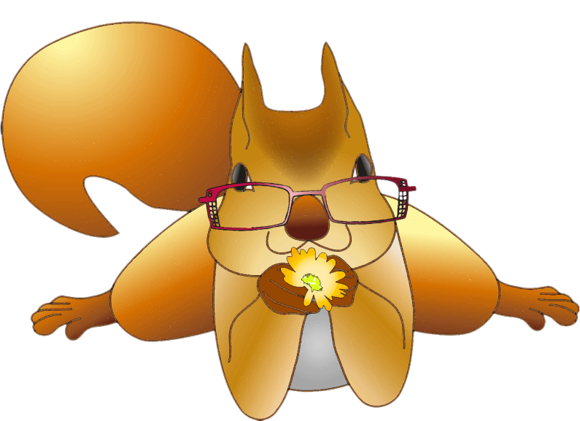
Module 4, Lesson 27
Let’s keep going!
Slide over another bead!

Slide 137
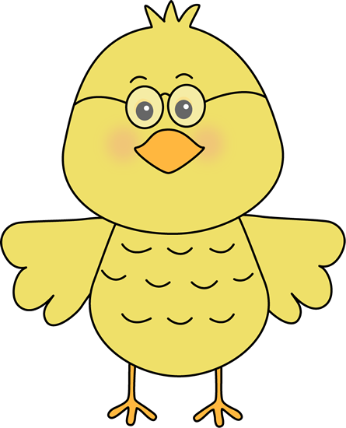
Module 4, Lesson 27
Slide another one over!

Slide 138
Module 4, Lesson 27
Another!

Slide 139
Module 4, Lesson 27
One more time!

Slide 140
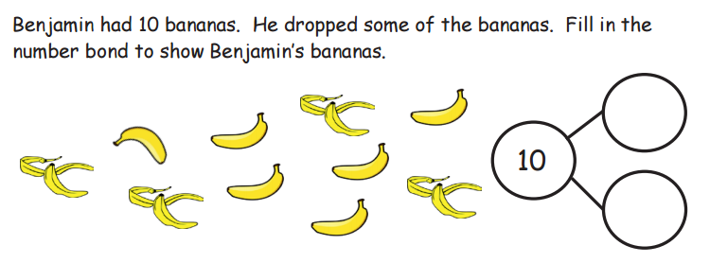

Slide 142
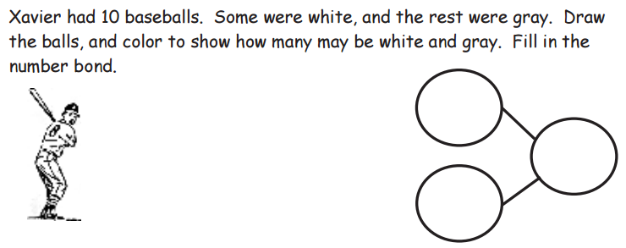

Slide 144
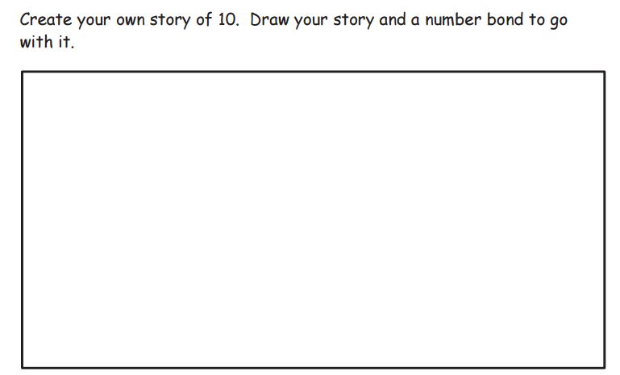

Slide 145
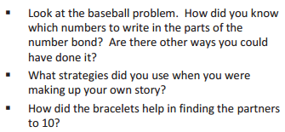
Debrief

Slide 146
Lesson 28
I can model decompositions of 10 using fingers, sets, linking cubes, and number bonds.

Slide 147
Module 4, Lesson 28
Fluency
Race to 0 Subtraction Game
Each partner rolls their die subtracts the number on their die from 5. Both partners state their equations. To win the game, subtract a number from 5 that equals 0 (only by rolling a 5). If neither partner rolls a 5, they both state their subtraction sentences out loud. Both partners roll again and subtract the new number on the die from 5. Both partners state their new subtraction sentences. Continue the subtraction race, rolling the dice and subtracting with speed and accuracy until one of the partners rolls a 5 and says, “5 – 5 = 0”.

Slide 148
Module 4, Lesson 28
Fluency
Number Bond Bracelet
Do you remember how many beads are on your number bond bracelets? Is 10 the whole (gesture) or part (gesture) of the beads? Take 1 of the beads, and slide it away from the others (click). Is 1 the whole or a part? Raise your hand when you know the other part. Now, write the number bond.

Slide 149
Module 4, Lesson 28
Fluency
Number Bond Bracelet
Take the next bead, and slide it away from the others to join the first one (click). How many beads have you slid so far? Is 2 the whole or a part? Raise your hand when you know the other part. Now, write the number bond.

Slide 150
Module 4, Lesson 28
Fluency
Number Bond Bracelet
Take the next bead, and slide it away from the others to join the first one (click). How many beads have you slid so far? Is 3 the whole or a part? Raise your hand when you know the other part. Now, write the number bond.

Slide 151
Module 4, Lesson 28
Fluency
Number Bond Bracelet
Now, you finish finding the rest of the partners to 10 independently. Don’t forget to write the number bond for each set of partners!

Slide 152
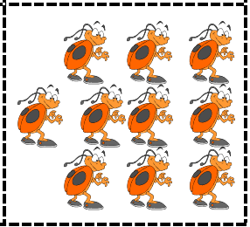
Module 4, Lesson 28
Fluency
Make 10 Matching Game
Shuffle and place the cards facedown in two equal rows. Partner A turns over two cards. If the total of the numbers on both cards is 10, then Partner A collects both cards. If not, then Partner A turns them back over in their original place facedown. Repeat for Partner B.

Slide 153
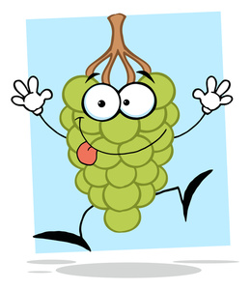
Application Problem
Module 4, Lesson 28
Use your clay to make 10 tiny grapes. With your marker, draw a pretty plate on your board. Now, put some of the grapes on the plate. How many grapes do you have in all? How many are on the plate? How many are not on the plate?
Draw a number bond about your work, and talk about it with your partner. Did she do it the same way?
Take the grapes off, and try again!

Slide 154
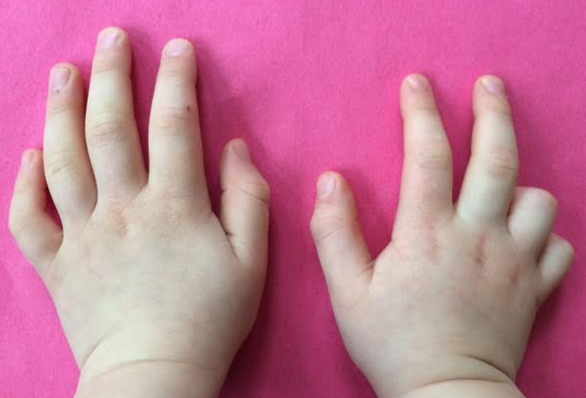
Module 4, Lesson 28
Show 8 on your fingers using the Math Way.
How many fingers are down? How many are up?
How is this like a number bond?

Slide 155
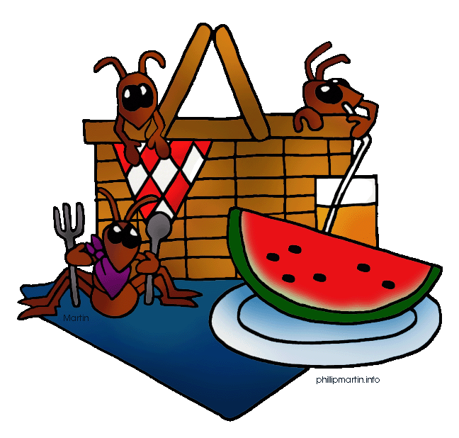
Module 4, Lesson 28
Imagine that another ant got full too, and left the blanket.
Break off another cube and put it with its full friend.
Draw a number bond!
Imagine it’s a beautiful summer day at the park,
and you are having a picnic with your friends. Now,
imagine that 10 ants come to share your picnic!
Pretend 1 ant got full and crawled away. Break off a
linking cube and make it crawl off the blanket. Draw a
number bond!
Let’s pretend your paper is a little picnic blanket. How many
ants do you have? Put them all on your blanket.
You have some cubes. Count your cubes.
Put all of your linking cubes together.

Slide 156
Module 4, Lesson 28
With your partner, continue to act out the story as the ants get full one by one! Each time, make a new number bond. Then make up your own picnic story!

Slide 157
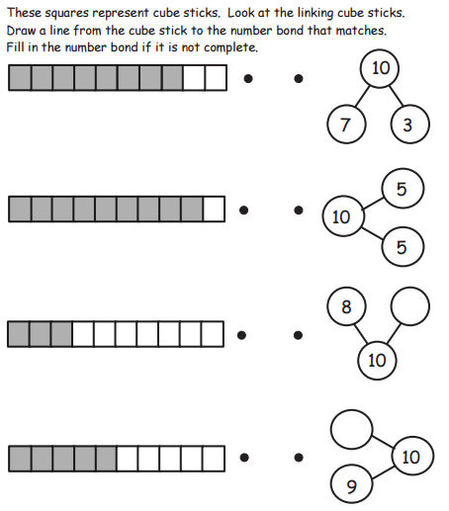

Slide 158
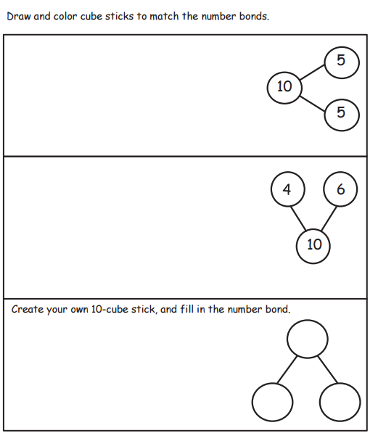

Slide 159
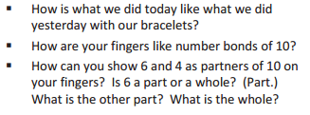
Debrief

Slide 160
Lesson 29
I can use 5-group drawings and equations to show addition stories.

Slide 161
Module 4, Lesson 29
Fluency
Core Fluency Differentiated Practice
Complete as many problems as you can in 96 seconds. Your goal is to do your very best and work hard to improve the next time we practice. When you finish them all AND get them all right, you get to move up to the next practice! Remember, you are not competing against your classmates. You are just competing against yourself!

Slide 162
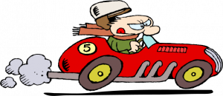
Module 4, Lesson 29
Fluency
1, 2, 3, Sit on 10 and 20
Now, we’ll play a fast counting game! Each person says the next 3 numbers. So, if I say 11, 12, 13, what would the next person say? And the next person? The next person after that will only say 20. Can you guess what you have to do if you say 10 or 20? By the end of the game, everyone will be sitting. After you say 20, the next person starts over with 1, 2, 3. Here we go!

Slide 163
Module 4, Lesson 29
Fluency
5-Group Flashes
How many dots do you see? How many more to make 10? Say the number sentence. Write the number sentence on your board. Get ready. Show me.

Slide 164
Module 4, Lesson 29
Fluency
5-Group Flashes
How many dots do you see? How many more to make 10? Say the number sentence. Write the number sentence on your board. Get ready. Show me.

Slide 165
Module 4, Lesson 29
Fluency
5-Group Flashes
How many dots do you see? How many more to make 10? Say the number sentence. Write the number sentence on your board. Get ready. Show me.

Slide 166
Module 4, Lesson 29
Fluency
5-Group Flashes
How many dots do you see? How many more to make 10? Say the number sentence. Write the number sentence on your board. Get ready. Show me.

Slide 167
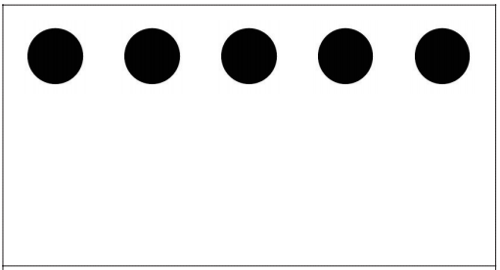
Module 4, Lesson 29
Fluency
5-Group Flashes
How many dots do you see? How many more to make 10? Say the number sentence. Write the number sentence on your board. Get ready. Show me.

Slide 168
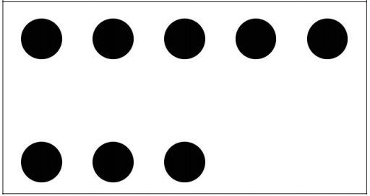
Module 4, Lesson 29
Fluency
5-Group Flashes
How many dots do you see? How many more to make 10? Say the number sentence. Write the number sentence on your board. Get ready. Show me.

Slide 169
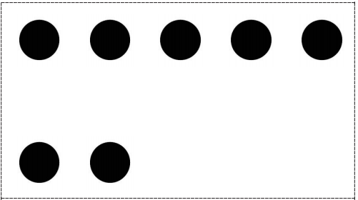
Module 4, Lesson 29
Fluency
5-Group Flashes
How many dots do you see? How many more to make 10? Say the number sentence. Write the number sentence on your board. Get ready. Show me.

Slide 170
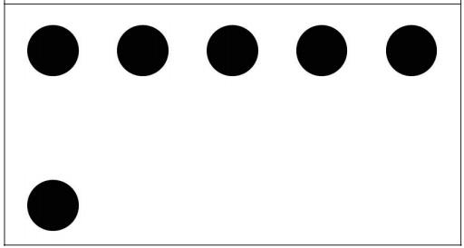
Module 4, Lesson 29
Fluency
5-Group Flashes
How many dots do you see? How many more to make 10? Say the number sentence. Write the number sentence on your board. Get ready. Show me.

Slide 171
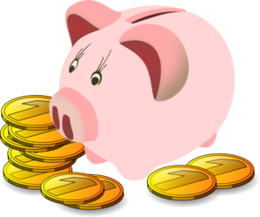
Application Problem
Module 4, Lesson 29
Emma had 9 pennies. Show her pennies in the middle of the desk. She wanted to use 4 pennies to buy some gum and 5 pennies to buy a balloon. Count and slide apart the pennies she needs to buy the gum and the balloon. On your paper, show the number bond that corresponds to her pennies now.
Now, slide your groups of pennies together again. How many pennies in all? Would you need to create a new number bond about what you just did? Turn and talk to your partner about your work.

Slide 172
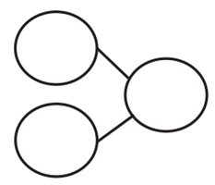
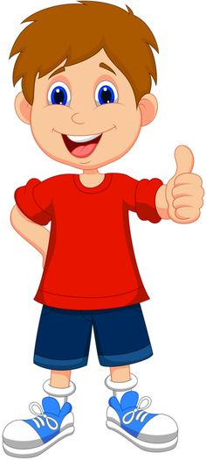
Module 4, Lesson 29
Toby had 9 tasty berries. 5 were strawberries,
and 4 were blueberries.
9 = ____ + ____
Draw the berries, make a number bond,
and write a number sentence.

Slide 173
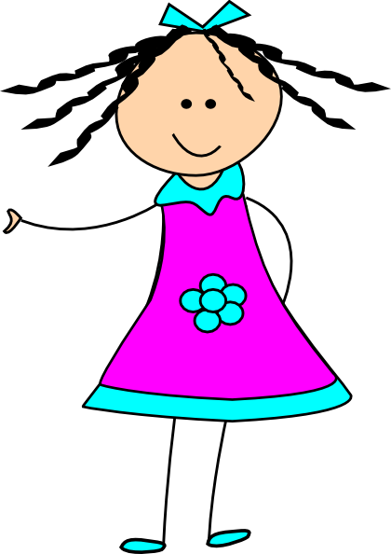
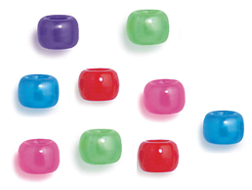
Module 4, Lesson 29
Kate had 6 beads. Her friend gave her 3 more beads.
Now, Kate has 9 beads.
____ + ____ = 9
Draw the beads, make a number bond,
and write a number sentence.

Slide 174
Module 4, Lesson 29
Draw 9 the 5-group way. Circle the group of dots at the top.
Write two number sentences.
9 = ____ + ____
____ + ____ = 9

Slide 175
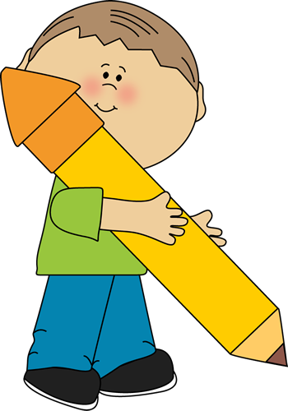
Module 4, Lesson 29
Work with your partner to draw 8 the 5-group way.
See if you can see the 5 inside the 8, circle it, and create
number sentences about your picture.
____ = ____ + ____
____ + ____ = ____

Slide 177
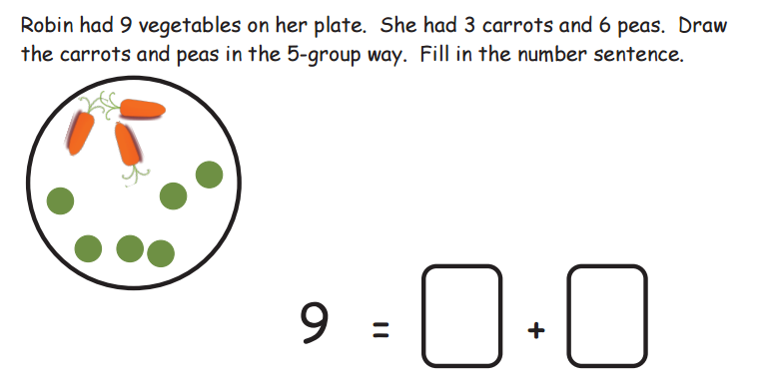

Slide 180
Debrief

Slide 181
Lesson 30
I can use 5-group drawings and equations to show addition stories.

Slide 182
Module 4, Lesson 30
Fluency
Core Fluency Differentiated Practice
Complete as many problems as you can in 96 seconds. Your goal is to do your very best and work hard to improve the next time we practice. When you finish them all AND get them all right, you get to move up to the next practice! Remember, you are not competing against your classmates. You are just competing against yourself!

Slide 183
Module 4, Lesson 30
Fluency
Spill the Beans
Take 3 beans out of the bag, and place them in the cup. Shake the cup gently, and then spill the beans onto the personal white board. Count the number of red and the number of white, and record as an addition sentence. Erase, and repeat a few more times.

Slide 184
Module 4, Lesson 30
Fluency
Flash Five
Quick! Show me 5 as fast as you can!

Slide 185
Module 4, Lesson 30
Fluency
Flash Five
Now, show me 5 on the other hand.

Slide 186
Module 4, Lesson 30
Fluency
Flash Five
Show me 1 the Math Way.

Slide 187
Module 4, Lesson 30
Fluency
Flash Five
We want to add 5 to it. We could put up 5 fingers one at a time… Can you think of a faster way?

Slide 188
Module 4, Lesson 30
Fluency
Flash Five
How many fingers are you showing now? Say the addition sentence starting with 1, please.

Slide 189
Module 4, Lesson 30
Fluency
Flash Five
Show me 2 the Math Way.

Slide 190
Module 4, Lesson 30
Fluency
Flash Five
Add 5 to it. Can you do it quickly?

Slide 191
Module 4, Lesson 30
Fluency
Flash Five
How many fingers are you showing now? Say the addition sentence starting with 2, please.

Slide 192
Module 4, Lesson 30
Fluency
Flash Five
3 + 5

Slide 193
Module 4, Lesson 30
Fluency
Flash Five
4 + 5

Slide 194
Module 4, Lesson 30
Fluency
Flash Five
5 + 5

Slide 195
Application Problem
Module 4, Lesson 30
Pretend your linking cubes are pears from the pear tree! How many pears do you have in all? Using your linking cubes, put 5 pears in the tree and 5 pears on the ground. Make a number bond about the pears in your picture. Use your math words to tell your partner about the pears. Can you think of a number sentence?

Slide 196
Application Problem
Module 4, Lesson 30
Now, show another pear falling out of the tree. How many cubes are in the tree now? Would your number bond change? Is there a different number sentence you would use to tell about what you just did? Talk about your ideas with your partner.

Slide 197
Module 4, Lesson 30
Nancy had 10 beans. She picked up 6 in one hand and 4 in the other. Draw Nancy’s beans.
10 = ____ + ____
Make a number bond and write a
number sentence!

Slide 198
Module 4, Lesson 30
Shelly had 8 presents. Her friend gave her 2 more presents! Shelly has 10 presents now. Draw squares to show how many presents Shelly started with. Color them in. Draw 2 empty squares to show how many her friend gave her.
____ + ____ = 10
Make a number bond and write a
number sentence!

Slide 199
Module 4, Lesson 30
Draw 10 the 5-group way. Circle the group of 5 dots at the top. Let’s write two different number sentences about our picture.
10 = ____ + ____
____ + ____ = 10

Slide 200
Module 4, Lesson 30
Work with your partner to draw 10 the 5-group way. Decide how to separate it into two groups. Circle one of the groups. Make two different number sentences about your new picture.
____ = ____ + ____
____ + ____ = ____

Slide 205
Debrief

Slide 206
Lesson 31
I can solve addition problems with totals of 9 and 10.

Slide 207
Missing Number
Sprint A
Module 4, Lesson 31
Fluency

Slide 208
Missing Number
Sprint B
Module 4, Lesson 31
Fluency

Slide 209
Module 4, Lesson 31
Fluency
Ready, Set, Add!
Work with your partner. Both of you put one hand behind your back. Pump your other fist two times as you say, “Ready, set,” and then the third time, show a number of fingers as you say, “Add!” Race to say an addition sentence that matches the number of fingers shown. The one who says it fastest repeats it for both to hear. The second partner flips the addition sentence. Repeat.

Slide 210
Application Problem
Module 4, Lesson 31
5 children were playing soccer in the park. Draw the children. 4 more children came to play. Draw the new players. How many children were playing soccer? How did you know? Turn and talk to your partner about your answer. Do you agree?

Slide 211
Module 4, Lesson 31
____ = ____ + ____
6 bears were walking in the forest. Show the bears with your counters. 3 more bears came to walk with them. Show the new bears with your counters. How many bears were walking in the forest altogether?

Slide 212
Module 4, Lesson 31
____ = ____ + ____
There were 3 sleeping bears and 7 bears playing. Show your groups of bears with your counters. How many bears in all?

Slide 213
Module 4, Lesson 31
Try this one
with your partner!
____ = ____ + ____
Maggie had 4 pennies. Her mom gave her 5 more pennies. How many pennies does Maggie have now? Draw the pennies and make a number sentence.

Slide 214
Module 4, Lesson 31
Try this one
with your partner!
____ = ____ + ____
John had 2 circle magnets and 8 square magnets. How
many magnets did he have altogether?

Slide 215
Module 4, Lesson 31
Think up an addition story with your partner. Draw the
picture and write the number sentence!
____ = ____ + ____
Hmmm…

Slide 220
Debrief

Slide 221
Lesson 32
I can use 5-group drawings to solve word problems with totals of 9 and 10.

Slide 222
Module 4, Lesson 32
Fluency
Counting by Ones to 30 with the Rekenrek
How many?

Slide 223
Module 4, Lesson 32
Fluency
Counting by Ones to 30 with the Rekenrek
How many?

Slide 224
Module 4, Lesson 32
Fluency
Counting by Ones to 30 with the Rekenrek
How many?

Slide 225
Module 4, Lesson 32
Fluency
Counting by Ones to 30 with the Rekenrek
How many?

Slide 226
Module 4, Lesson 32
Fluency
Counting by Ones to 30 with the Rekenrek
20. 1 more is 21. How many?

Slide 227
Module 4, Lesson 32
Fluency
Counting by Ones to 30 with the Rekenrek
21. 1 more is 22. How many?

Slide 228
Module 4, Lesson 32
Fluency
Counting by Ones to 30 with the Rekenrek
22. 1 more is 23. How many?

Slide 229
Module 4, Lesson 32
Fluency
Counting by Ones to 30 with the Rekenrek
23. 1 more is ___. How many?

Slide 230
Module 4, Lesson 32
Fluency
Counting by Ones to 30 with the Rekenrek
24. 1 more is ___. How many?

Slide 231
Module 4, Lesson 32
Fluency
Counting by Ones to 30 with the Rekenrek
25. 1 more is ___. How many?

Slide 232
Module 4, Lesson 32
Fluency
Counting by Ones to 30 with the Rekenrek
26. 1 more is ___. How many?

Slide 233
Module 4, Lesson 32
Fluency
Counting by Ones to 30 with the Rekenrek
27. 1 more is ___. How many?

Slide 234
Module 4, Lesson 32
Fluency
Counting by Ones to 30 with the Rekenrek
28. 1 more is ___. How many?

Slide 235
Module 4, Lesson 32
Fluency
Counting by Ones to 30 with the Rekenrek
29. 1 more is ___. How many?

Slide 236
Module 4, Lesson 32
Fluency
Break Apart Numbers
Complete as many number bonds as you can in one minute.

Slide 237
Module 4, Lesson 32
Fluency
5-Group Puzzles
Put the puzzles together to make 10.
Then write the number bond.

Slide 238
Application Problem
Module 4, Lesson 32
Chen had 9 pencils. Some of his pencils were red, and some
were blue. Draw Chen’s pencils.
Make a number bond about your pencils. Now, turn and talk to your partner about your pictures and your number bond. Do you pictures look the same? Are your number bonds the same? Are they both correct?

Slide 239
Module 4, Lesson 32
9 = ____ + ____
Michael has 9 toy blocks. Some are large, and some are small.
I need someone to tell me how many you think are large. Let’s draw a picture and complete the number sentence!

Slide 240
Module 4, Lesson 32
Try this one
with your partner!
____ = ____ + ____
Susie had a plate of 9 cookies. Some were vanilla and some
were chocolate. How many of each kind did she have? You decide! Make a picture and write a number sentence.

Slide 241
Module 4, Lesson 32
Try this one
with your partner!
____ = ____ + ____
Jamal had a basket of 10 blocks. Some were white and some
were gray. Show Jamal’s blocks, and write the number sentence.

Slide 246
Debrief

Slide 247
Lesson 33
I can solve subtraction problems using numbers to 10.

Slide 248
Module 4, Lesson 33
Fluency
Core Fluency Differentiated Practice
Complete as many problems as you can in 96 seconds. Your goal is to do your very best and work hard to improve the next time we practice. When you finish them all AND get them all right, you get to move up to the next practice! Remember, you are not competing against your classmates. You are just competing against yourself!

Slide 249
Module 4, Lesson 33
Fluency
1, 2, 3, Sit on 10, 20, and 30
Now, we’ll play a fast counting game! Each person says the next 3 numbers. So, if I say 21, 22, 23, what would the next person say? And the next person? The next person after that will only say 30. Can you guess what you have to do if you say 10, 20, or 30? By the end of the game, everyone will be sitting. After you say 30, the next person starts over with 1, 2, 3. Here we go!

Slide 250
Module 4, Lesson 33
Fluency
Hide 1
Raise your hand when you know how many dots. Ready? Now, hide 1. You can use your hand to hide one of the dots from your eyes, or you can just see it in your mind. Now, how many dots are left?

Slide 251
Module 4, Lesson 33
Fluency
Hide 1
Raise your hand when you know how many dots. Ready? Now, hide 1. You can use your hand to hide one of the dots from your eyes, or you can just see it in your mind. Now, how many dots are left?

Slide 252
Module 4, Lesson 33
Fluency
Hide 1
Raise your hand when you know how many dots. Ready? Now, hide 1. You can use your hand to hide one of the dots from your eyes, or you can just see it in your mind. Now, how many dots are left?

Slide 253
Module 4, Lesson 33
Fluency
Hide 1
Raise your hand when you know how many dots. Ready? Now, hide 1. You can use your hand to hide one of the dots from your eyes, or you can just see it in your mind. Now, how many dots are left?

Slide 254
Module 4, Lesson 33
Fluency
Hide 1
Raise your hand when you know how many dots. Ready? Now, hide 1. You can use your hand to hide one of the dots from your eyes, or you can just see it in your mind. Now, how many dots are left?

Slide 255
Module 4, Lesson 33
Fluency
Hide 1
Raise your hand when you know how many dots. Ready? Now, hide 1. You can use your hand to hide one of the dots from your eyes, or you can just see it in your mind. Now, how many dots are left?

Slide 256
Module 4, Lesson 33
Fluency
Hide 1
Raise your hand when you know how many dots. Ready? Now, hide 1. You can use your hand to hide one of the dots from your eyes, or you can just see it in your mind. Now, how many dots are left?

Slide 257
Module 4, Lesson 33
Fluency
Hide 1
Raise your hand when you know how many dots. Ready? Now, hide 1. You can use your hand to hide one of the dots from your eyes, or you can just see it in your mind. Now, how many dots are left?

Slide 258
Module 4, Lesson 33
Fluency
Hide 1
Raise your hand when you know how many dots. Ready? Now, hide 1. You can use your hand to hide one of the dots from your eyes, or you can just see it in your mind. Now, how many dots are left?

Slide 259
Application Problem
Module 4, Lesson 33
You are going to play a game with your partner. Partner A, pretend your cubes are ants and you paper is a picnic blanket. Count your ants, and put them all on the picnic blanket.
Now, pretend some of the ants crawled off the blanket. Slide some of your ants off the blanket to show the ones that crawled away.
Partner B, your job is to make a number bond showing the 9 ants that were on the blanket, the ones that stayed, and the ones that crawled away. Partner A, check the number bond to see if you agree.
Now, it’s Partner B’s turn to show some ants leaving the blanket!

Slide 260
Module 4, Lesson 33
____ - ____ = ____
Pretend you have a family of 9 bears. Put 9 bears in front of you. One bear is hungry and wants to go to the honey tree! Take 1 bear and scoot him across your desk to show his adventure. 8 are left.

Slide 261
Module 4, Lesson 33
____ - ____ = ____
Send your bear back home. Let’s pretend 2 bears are hungry this time. Send them to the forest. We need a new number sentence and a new number bond.

Slide 262
Module 4, Lesson 33
____ - ____ = ____
Send your bears back home. Now, 3 bears are hungry!

Slide 263
Module 4, Lesson 33
____ - ____ = ____
Send your bears back home. Now, 4 bears are hungry!

Slide 264
Module 4, Lesson 33
____ - ____ = ____
Send your bears back home. Now, 5 bears are hungry!

Slide 265
Module 4, Lesson 33
____ - ____ = ____
Send your bears back home. Now, 6 bears are hungry!

Slide 266
Module 4, Lesson 33
____ - ____ = ____
Send your bears back home. Now, 7 bears are hungry!

Slide 267
Module 4, Lesson 33
____ - ____ = ____
Send your bears back home. Now, 8 bears are hungry!

Slide 268
Module 4, Lesson 33
Put your bears away and take out your linking cubes.
How many do you have?
Let’s pretend your linking cubes are little cars. You have
10 cars. 9 of them drove away. 1 is left.
____ - ____ = ____

Slide 269
Module 4, Lesson 33
You have 10 cars. 8 of them drove away. 2 are left.
____ - ____ = ____

Slide 270
Module 4, Lesson 33
You have 10 cars. 7 of them drove away. 3 are left.
____ - ____ = ____

Slide 271
Module 4, Lesson 33
You have 10 cars. 6 of them drove away. 4 are left.
____ - ____ = ____

Slide 272
Module 4, Lesson 33
You have 10 cars. 5 of them drove away. 5 are left.
____ - ____ = ____

Slide 273
Module 4, Lesson 33
You have 10 cars. 4 of them drove away. 6 are left.
____ - ____ = ____

Slide 274
Module 4, Lesson 33
You have 10 cars. 3 of them drove away. 7 are left.
____ - ____ = ____

Slide 275
Module 4, Lesson 33
You have 10 cars. 2 of them drove away. 8 are left.
____ - ____ = ____

Slide 276
Module 4, Lesson 33
You have 10 cars. 1 of them drove away. 9 are left.
____ - ____ = ____

Slide 277
Module 4, Lesson 33
Now, pretend your cubes are trains in the station. Some of them
drive away. With your partner, act out this story several times. Each time, write the new number sentence.
____ - ____ = ____

Slide 282
Debrief

Slide 283
Lesson 34
I can show subtraction story problems by breaking off, crossing out, and hiding a part.

Slide 284
Module 4, Lesson 34
Fluency
Hide 2
Raise your hand when you know how many dots. Ready? Now, hide 2. You can use your hand to hide two of the dots from your eyes, or you can just see it in your mind. Now, how many dots are left?

Slide 285
Module 4, Lesson 34
Fluency
Hide 2
Raise your hand when you know how many dots. Ready? Now, hide 2. You can use your hand to hide two of the dots from your eyes, or you can just see it in your mind. Now, how many dots are left?

Slide 286
Module 4, Lesson 34
Fluency
Hide 2
Raise your hand when you know how many dots. Ready? Now, hide 2. You can use your hand to hide two of the dots from your eyes, or you can just see it in your mind. Now, how many dots are left?

Slide 287
Module 4, Lesson 34
Fluency
Hide 2
Raise your hand when you know how many dots. Ready? Now, hide 2. You can use your hand to hide two of the dots from your eyes, or you can just see it in your mind. Now, how many dots are left?

Slide 288
Module 4, Lesson 34
Fluency
Hide 2
Raise your hand when you know how many dots. Ready? Now, hide 2. You can use your hand to hide two of the dots from your eyes, or you can just see it in your mind. Now, how many dots are left?

Slide 289
Module 4, Lesson 34
Fluency
Hide 2
Raise your hand when you know how many dots. Ready? Now, hide 2. You can use your hand to hide two of the dots from your eyes, or you can just see it in your mind. Now, how many dots are left?

Slide 290
Module 4, Lesson 34
Fluency
Hide 2
Raise your hand when you know how many dots. Ready? Now, hide 2. You can use your hand to hide two of the dots from your eyes, or you can just see it in your mind. Now, how many dots are left?

Slide 291
Module 4, Lesson 34
Fluency
Hide 2
Raise your hand when you know how many dots. Ready? Now, hide 2. You can use your hand to hide two of the dots from your eyes, or you can just see it in your mind. Now, how many dots are left?

Slide 292
Module 4, Lesson 34
Fluency
What is Less?
Think of a number that is less than 2. Write it on your personal white board, and show me. Write this subtraction sentence on your board: 2 minus 1. Write the answer and show me. Say the subtraction sentence.
2

Slide 293
Module 4, Lesson 34
Fluency
What is Less?
Think of a number that is less than 3. Write it on your personal white board, and show me. Write this subtraction sentence on your board: 3 minus 1. Write the answer and show me. Say the subtraction sentence. (Repeat with 3 minus 2.)
3

Slide 294
Module 4, Lesson 34
Fluency
What is Less?
Think of a number that is less than 4. Write it on your personal white board, and show me. Write this subtraction sentence on your board: 4 minus 1. Write the answer and show me. Say the subtraction sentence. (Repeat with 4 minus 2, 3.)
4

Slide 295
Module 4, Lesson 34
Fluency
What is Less?
Think of a number that is less than 5. Write it on your personal white board, and show me. Write this subtraction sentence on your board: 5 minus 1. Write the answer and show me. Say the subtraction sentence. (Repeat with 5 minus 2, 3, 4.)
5

Slide 296
Module 4, Lesson 34
Fluency
Snap!
Show your partner your 5-stick and then put it behind your back. When your partner says, “Snap!” quickly break your stick into two parts. Show your partner one part and have them guess the hidden part. Show the hidden part to check your partner’s guess. Both partners say the subtraction sentence together (“5 take away 2 equals 3”)
Take turns!

Slide 297
Application Problem
Module 4, Lesson 34
Tony had 8 checkers. His friend took 3 away. How
many checkers did Tony have left?
Draw a picture, and make a number bond and a number sentence. Show your work to a friend. Did you both do it the same way?

Slide 298
Module 4, Lesson 34
Take out your linking cube stick. How many cubes do you have?
Break off 3 cubes from the end. How many cubes do you have left? Let’s make a number bond and a number sentence!
____ - ____ = ____

Slide 299
Module 4, Lesson 34
Now, break off 4 cubes from the end. How many cubes do you have left? Let’s make a number bond and a number sentence!
____ - ____ = ____

Slide 300
Module 4, Lesson 34
Now, break off 6 cubes from the end. How many cubes do you have left? Let’s make a number bond and a number sentence!
____ - ____ = ____

Slide 301
Module 4, Lesson 34
Put your linking cubes away and listen to my story…
Ellie had 9 grapes. Draw the grapes on your board. She shared 4 grapes with a friend. How many grapes does Ellie have left?
____ - ____ = ____

Slide 302
Module 4, Lesson 34
This time, Ellie had 10 grapes. She shared 8 grapes. How will your picture and your number sentence change?
____ - ____ = ____

Slide 303
Module 4, Lesson 34
This time, Ellie had 7 grapes. She shared 3 grapes. How will your picture and your number sentence change?
____ - ____ = ____

Slide 304
Module 4, Lesson 34
Get out your bears! It’s time to work with your partner!
How many bears do you have? Let’s pretend 4 bears went to sleep in a cave. Hide 4 bears under the bowl to show the sleepy bears. How many bears do you have left?
____ - ____ = ____

Slide 305
Module 4, Lesson 34
Take turns with your partner hiding some sleepy bears.
Each time, write the number bond and the number sentence.
____ - ____ = ____

Slide 310
Debrief

Slide 311
Lesson 35
I can break apart 9 using 5-group drawings. I can write a subtraction equation to match it.

Slide 312
Module 4, Lesson 35
Fluency
Core Fluency Differentiated Practice
Complete as many problems as you can in 96 seconds. Your goal is to do your very best and work hard to improve the next time we practice. When you finish them all AND get them all right, you get to move up to the next practice! Remember, you are not competing against your classmates. You are just competing against yourself!

Slide 313
Module 4, Lesson 35
Fluency
Spill the Beans
Take 3 beans out of the bag, and place them in the cup. Shake the cup gently, and then spill the beans onto the personal white board. Take away the red beans, and record as a subtraction sentence. Erase, and repeat a few more times.

Slide 314
Module 4, Lesson 35
Fluency
Happy Counting
Let’s play Happy Counting! When I hold my hand like this (point two fingers up), I want you to count up. If I put my hand like this (point two fingers down), I want you to count down. If I do this (close fist), that means stop, but try hard to remember the last number you said. Ready?
(Continue the count to 20.)

Slide 315
Application Problem
Module 4, Lesson 35
Steve had 9 pennies. He wanted to put some pennies into each of his two pockets. Use your pennies to show one way he could have separated them. Make a number bond about your idea.
Show your number bond to your partner. Did she do it the same way? How many different ways can you separate the pennies?

Slide 316
Module 4, Lesson 35
Connie had 9 bouncy balls. 3 of the balls were green.
How many balls were not green?
____ - ____ = ____
Watch me draw the balls in the 5-group way
and circle the balls that were green.

Slide 317
Module 4, Lesson 35
Doug had 9 special rocks. Draw the rocks. He had 4 white rocks. Circle 4 rocks to show the white ones. Cross off that part to see how many were left. How many rocks were another color?
____ - ____ = ____

Slide 318
Time for partner work!
Module 4, Lesson 35
Calla had 9 apples. Draw her apples. 7 of her apples were green. Circle and cross of the 7 green apples. Write a number sentence to tell me how many apples were not green.
____ - ____ = ____

Slide 319
Time for partner work!
Module 4, Lesson 35
What if Calla had only 1 green apple? How would your picture and number sentence change?
____ - ____ = ____

Slide 320
Time for partner work!
Module 4, Lesson 35
Now, you and your partner can take turns deciding how many green apples Calla had. Each time, make a new picture and write the number sentence. Raise your hand for me to see
each new number sentence!
____ - ____ = ____

Slide 325
Debrief

Slide 326
Lesson 36
I can break apart 10 using 5-group drawings. I can write a subtraction equation to match it.

Slide 327
Missing Number
Sprint A
Module 4, Lesson 36
Fluency

Slide 328
Missing Number
Sprint B
Module 4, Lesson 36
Fluency

Slide 329
Module 4, Lesson 36
Fluency
Counting by Ones to 30 with the Rekenrek
How many?

Slide 330
Module 4, Lesson 36
Fluency
Counting by Ones to 30 with the Rekenrek
How many?

Slide 331
Module 4, Lesson 36
Fluency
Counting by Ones to 30 with the Rekenrek
How many?

Slide 332
Module 4, Lesson 36
Fluency
Counting by Ones to 30 with the Rekenrek
How many?

Slide 333
Module 4, Lesson 36
Fluency
Counting by Ones to 30 with the Rekenrek
20. 1 more is 21. How many?

Slide 334
Module 4, Lesson 36
Fluency
Counting by Ones to 30 with the Rekenrek
21. 1 more is 22. How many?

Slide 335
Module 4, Lesson 36
Fluency
Counting by Ones to 30 with the Rekenrek
22. 1 more is 23. How many?

Slide 336
Module 4, Lesson 36
Fluency
Counting by Ones to 30 with the Rekenrek
23. 1 more is ___. How many?

Slide 337
Module 4, Lesson 36
Fluency
Counting by Ones to 30 with the Rekenrek
24. 1 more is ___. How many?

Slide 338
Module 4, Lesson 36
Fluency
Counting by Ones to 30 with the Rekenrek
25. 1 more is ___. How many?

Slide 339
Module 4, Lesson 36
Fluency
Counting by Ones to 30 with the Rekenrek
26. 1 more is ___. How many?

Slide 340
Module 4, Lesson 36
Fluency
Counting by Ones to 30 with the Rekenrek
27. 1 more is ___. How many?

Slide 341
Module 4, Lesson 36
Fluency
Counting by Ones to 30 with the Rekenrek
28. 1 more is ___. How many?

Slide 342
Module 4, Lesson 36
Fluency
Counting by Ones to 30 with the Rekenrek
29. 1 more is ___. How many?

Slide 343
Application Problem
Module 4, Lesson 36
Martin had 10 building blocks. Pretend your linking cubes are his blocks. Count to make sure there are 10. He shared 4 blocks with his sister. Move 4 blocks to show the ones he shared. How many blocks did he still have? Make a number about the story. Now, make a number sentence. Show your work to your partner. Did she do it the same way?

Slide 344
Application Problem
Module 4, Lesson 36
Put your blocks back together. Act out the story again, sharing a different number of blocks this time. How does your number sentence change?

Slide 345
Module 4, Lesson 36
Melanie had 10 peaches. Draw her peaches in the 5-group way. 4 of her peaches were not yet ripe. Circle and cross out the
4 unripe peaches. How many peaches were ready to eat?
____ - ____ = ____

Slide 346
Module 4, Lesson 36
Chris had 10 toy cars. Draw squares in the 5-group way to show all of his cars. 2 of the cars had no wheels. Circle and then cross off the cars with no wheels.
____ - ____ = ____

Slide 347
Time for partner work!
Module 4, Lesson 36
Make up some ten stories of your own. Show your work on your board. Raise your hand when you have your number sentence.
____ - ____ = ____

Slide 352
Debrief

Slide 353
Lesson 37
I can add or subtract 0 to get the same number.

Slide 354
Module 4, Lesson 37
Fluency
Imagine More to Add 5
Let’s do a few together. Then, you will finish on your own.

Slide 355
Module 4, Lesson 37
Fluency
Hide 1
Raise your hand when you know how many dots. Ready? Now, hide 1. You can use your hand to hide one of the dots from your eyes, or you can just see it in your mind. Now, how many dots are left? Say the subtraction sentence starting with 2. Ready?

Slide 356
Module 4, Lesson 37
Fluency
Hide 1
Raise your hand when you know how many dots. Ready? Now, hide 1. You can use your hand to hide one of the dots from your eyes, or you can just see it in your mind. Now, how many dots are left? Say the subtraction sentence starting with 2. Ready?

Slide 357
Module 4, Lesson 37
Fluency
Hide 1
Raise your hand when you know how many dots. Ready? Now, hide 1. You can use your hand to hide one of the dots from your eyes, or you can just see it in your mind. Now, how many dots are left? Say the subtraction sentence starting with 2. Ready?

Slide 358
Module 4, Lesson 37
Fluency
Hide 1
Raise your hand when you know how many dots. Ready? Now, hide 1. You can use your hand to hide one of the dots from your eyes, or you can just see it in your mind. Now, how many dots are left? Say the subtraction sentence starting with 2. Ready?

Slide 359
Module 4, Lesson 37
Fluency
Hide 1
Raise your hand when you know how many dots. Ready? Now, hide 1. You can use your hand to hide one of the dots from your eyes, or you can just see it in your mind. Now, how many dots are left? Say the subtraction sentence starting with 2. Ready?

Slide 360
Module 4, Lesson 37
Fluency
Cross Out 2 to Subtract
Let’s do a few together. Then, you will finish on your own.

Slide 361
Module 4, Lesson 37
I need someone to start at the beginning of the number path on the floor. Count and walk 5 spaces to get to the number 5.
I want to make an addition sentence starting with the number 5. Would I be adding more or taking some away?
Go forward 3 hops on the path to show 3 more.
Where did you land?
What do you notice on the floor and on the board?
Do you remember what we call this?
____ + ____ = ____

Slide 362
Module 4, Lesson 37
Now, I need someone to stand on the number 8. I want to make a subtraction sentence starting with 8. How do we do that?
8 - 3 = ____

Slide 363
Module 4, Lesson 37
There were 4 pigeons on the sidewalk. 5 more pigeons came to join them. How many pigeons are there now?
____ + ____ = ____

Slide 364
Module 4, Lesson 37
Pretend that the 5 pigeons flew away again.
Let’s show the new story!
____ - ____ = ____

Slide 365
Module 4, Lesson 37
There were 3 caterpillars eating leaves. 4 more caterpillars joined them. How many caterpillars are there now?
____ + ____ = ____

Slide 366
Module 4, Lesson 37
Pretend that the 4 caterpillars got full and crawled away.
Let’s show the new story!
____ - ____ = ____

Slide 367
Module 4, Lesson 37
There were 2 kites flying in the air. 6 more kites joined them. How many kites are there now?
____ + ____ = ____

Slide 368
Module 4, Lesson 37
Pretend the 6 kites were reeled in.
Let’s show the new story!
____ - ____ = ____

Slide 369
Module 4, Lesson 37
David found 6 pinecones in the park. He looked and looked, but he couldn’t find anymore. Then, it was time to go, so he took his 6 pinecones home. How many pinecones does he have now?
____ + ____ = ____
____ - ____ = ____

Slide 370
Module 4, Lesson 37
With your partner, make up some more stories and number sentences using zero. When you have one, raise your hand!
____ + ____ = ____
____ - ____ = ____

Slide 375
Debrief

Slide 376
Lesson 38
I can 1 to numbers 1-9 and look for a pattern using 5-group drawings and equations.

Slide 377
Module 4, Lesson 38
Fluency
Core Fluency Differentiated Practice
Complete as many problems as you can in 96 seconds. Your goal is to do your very best and work hard to improve the next time we practice. When you finish them all AND get them all right, you get to move up to the next practice! Remember, you are not competing against your classmates. You are just competing against yourself!

Slide 378
Module 4, Lesson 38
Fluency
Imagine 1 More
Raise your hand when you know how many dots. Ready? Now, imagine that there is 1 more. Now, how many dots with 1 more? Say the addition sentence starting with 2. Ready? Flip it!

Slide 379
Module 4, Lesson 38
Fluency
Imagine 1 More
Raise your hand when you know how many dots. Ready? Now, imagine that there is 1 more. Now, how many dots with 1 more? Say the addition sentence starting with 3. Ready? Flip it!

Slide 380
Module 4, Lesson 38
Fluency
Imagine 1 More
Raise your hand when you know how many dots. Ready? Now, imagine that there is 1 more. Now, how many dots with 1 more? Say the addition sentence starting with 4. Ready? Flip it!

Slide 381
Module 4, Lesson 38
Fluency
Imagine 1 More
Raise your hand when you know how many dots. Ready? Now, imagine that there is 1 more. Now, how many dots with 1 more? Say the addition sentence starting with 1. Ready? Flip it!

Slide 382
Module 4, Lesson 38
Fluency
Imagine 1 More
Raise your hand when you know how many dots. Ready? Now, imagine that there is 1 more. Now, how many dots with 1 more? Say the addition sentence starting with 0. Ready? Flip it!

Slide 383
Module 4, Lesson 38
Fluency
Building 1 More and 1 Less Towers
Build a tower as I give you the directions. Then, listen to my directions as we take our tower down.
1. One more is 2.

Slide 384
Module 4, Lesson 38
Fluency
Building 1 More and 1 Less Towers
Build a tower as I give you the directions. Then, listen to my directions as we take our tower down.
2. One more is 3.

Slide 385
Module 4, Lesson 38
Fluency
Building 1 More and 1 Less Towers
Build a tower as I give you the directions. Then, listen to my directions as we take our tower down.
3. One more is 4.

Slide 386
Module 4, Lesson 38
Fluency
Building 1 More and 1 Less Towers
Build a tower as I give you the directions. Then, listen to my directions as we take our tower down.
4. One more is 5.

Slide 387
Module 4, Lesson 38
Fluency
Building 1 More and 1 Less Towers
Build a tower as I give you the directions. Then, listen to my directions as we take our tower down.
5. One more is 6.

Slide 388
Module 4, Lesson 38
Fluency
Building 1 More and 1 Less Towers
Build a tower as I give you the directions. Then, listen to my directions as we take our tower down.
6. One more is 7.

Slide 389
Module 4, Lesson 38
Fluency
Building 1 More and 1 Less Towers
Build a tower as I give you the directions. Then, listen to my directions as we take our tower down.
7. One more is 8.

Slide 390
Module 4, Lesson 38
Fluency
Building 1 More and 1 Less Towers
Build a tower as I give you the directions. Then, listen to my directions as we take our tower down.
8. One more is 9.

Slide 391
Module 4, Lesson 38
Fluency
Building 1 More and 1 Less Towers
Build a tower as I give you the directions. Then, listen to my directions as we take our tower down.
9. One more is 10.

Slide 392
Module 4, Lesson 38
Fluency
Building 1 More and 1 Less Towers
Build a tower as I give you the directions. Then, listen to my directions as we take our tower down.
10. One less is 9.

Slide 393
Module 4, Lesson 38
Fluency
Building 1 More and 1 Less Towers
Build a tower as I give you the directions. Then, listen to my directions as we take our tower down.
8. One less is 7.

Slide 394
Module 4, Lesson 38
Fluency
Building 1 More and 1 Less Towers
Build a tower as I give you the directions. Then, listen to my directions as we take our tower down.
7. One less is 6.

Slide 395
Module 4, Lesson 38
Fluency
Building 1 More and 1 Less Towers
Build a tower as I give you the directions. Then, listen to my directions as we take our tower down.
6. One less is 5.

Slide 396
Module 4, Lesson 38
Fluency
Building 1 More and 1 Less Towers
Build a tower as I give you the directions. Then, listen to my directions as we take our tower down.
5. One less is 4.

Slide 397
Module 4, Lesson 38
Fluency
Building 1 More and 1 Less Towers
Build a tower as I give you the directions. Then, listen to my directions as we take our tower down.
4. One less is 3.

Slide 398
Module 4, Lesson 38
Fluency
Building 1 More and 1 Less Towers
Build a tower as I give you the directions. Then, listen to my directions as we take our tower down.
3. One less is 2.

Slide 399
Module 4, Lesson 38
Fluency
Building 1 More and 1 Less Towers
Build a tower as I give you the directions. Then, listen to my directions as we take our tower down.
2. One less is 1.

Slide 400
Module 4, Lesson 38
Fluency
Building 1 More and 1 Less Towers
Build a tower as I give you the directions. Then, listen to my directions as we take our tower down.
1. One less is 0.

Slide 401
Application Problem
Module 4, Lesson 38
Pretend your cubes are dinosaurs. 1 dinosaur went to the watering hole because he was thirsty. Move 1 of your cubes to the watering hole to show the thirsty dinosaur going to get his drink. 1 more dinosaur got thirsty, too. Add another cube to the one by the watering hole. How many thirsty dinosaurs are there now? Turn to your partner and talk about an addition sentence that would tell what you just did.
Another dinosaur got thirsty! Take her to the watering hole, too! Now, how many dinosaurs are at the watering hole? Talk to your partner about the new addition sentence.
Keep acting out the story until all the dinosaurs are drinking water.
Do you notice any patterns?

Slide 402
Module 4, Lesson 38
Let’s roll the die to see where to start!
____ + 1 = ____

Slide 403
Module 4, Lesson 38
Let’s roll the die to see where to start!
____ + 1 = ____

Slide 404
Module 4, Lesson 38
Let’s roll the die to see where to start!
____ + 1 = ____

Slide 405
Module 4, Lesson 38
Let’s roll the die to see where to start!
____ + 1 = ____

Slide 406
Module 4, Lesson 38
Did you notice a pattern?
Draw 1 dot in the 5-group way. Draw an empty circle next to it to show that we are adding 1. What is our number sentence? Let’s keep going until we get to 10!
Dots and Circles | Number Sentence

Slide 410
Debrief

Slide 411
Lesson 39
I can find the number that makes 10 for numbers 1-9. I can record each with a 5-group drawing.

Slide 412
Module 4, Lesson 39
Fluency
Core Fluency Differentiated Practice
Complete as many problems as you can in 96 seconds. Your goal is to do your very best and work hard to improve the next time we practice. When you finish them all AND get them all right, you get to move up to the next practice! Remember, you are not competing against your classmates. You are just competing against yourself!

Slide 413
Module 4, Lesson 39
Fluency
Growing Apples to 10
Roll the die. Use the number on the die to determine how many red beans to place on the apple tree. Arrange the beans in 5-groups. Count how many more are needed to make 10. Say, “I have ___. I need ___ more to make 10.” Do not remove the beans. Roll the die again. Count to see if there are enough spaces left over for that many beans. If the number goes over 10, and there are not enough spaces, roll again to get a smaller number. Then, place that many beans on the apple tree. State the new amount and how many more are needed to make 10. Continue until you make 10.

Slide 414
Module 4, Lesson 39
Fluency
5-Group Peek-a-Boo
I’m going to show you my 5-group cards, but only for a second! Quickly count the dots and raise your hand when you know how many. Remember to wait for the snap.

Slide 415
Module 4, Lesson 39
Fluency
5-Group Peek-a-Boo
I’m going to show you my 5-group cards, but only for a second! Quickly count the dots and raise your hand when you know how many. Remember to wait for the snap.

Slide 416
Module 4, Lesson 39
Fluency
5-Group Peek-a-Boo
I’m going to show you my 5-group cards, but only for a second! Quickly count the dots and raise your hand when you know how many. Remember to wait for the snap.

Slide 417
Module 4, Lesson 39
Fluency
5-Group Peek-a-Boo
I’m going to show you my 5-group cards, but only for a second! Quickly count the dots and raise your hand when you know how many. Remember to wait for the snap.

Slide 418
Module 4, Lesson 39
Fluency
5-Group Peek-a-Boo
I’m going to show you my 5-group cards, but only for a second! Quickly count the dots and raise your hand when you know how many. Remember to wait for the snap.

Slide 419
Module 4, Lesson 39
Fluency
5-Group Peek-a-Boo
I’m going to show you my 5-group cards, but only for a second! Quickly count the dots and raise your hand when you know how many. Remember to wait for the snap.

Slide 420
Module 4, Lesson 39
Fluency
5-Group Peek-a-Boo
I’m going to show you my 5-group cards, but only for a second! Quickly count the dots and raise your hand when you know how many. Remember to wait for the snap.

Slide 421
Module 4, Lesson 39
Fluency
5-Group Peek-a-Boo
I’m going to show you my 5-group cards, but only for a second! Quickly count the dots and raise your hand when you know how many. Remember to wait for the snap.

Slide 422
Module 4, Lesson 39
Fluency
5-Group Peek-a-Boo
I’m going to show you my 5-group cards, but only for a second! Quickly count the dots and raise your hand when you know how many. Remember to wait for the snap.

Slide 423
Module 4, Lesson 39
Fluency
5-Group Peek-a-Boo
I’m going to show you my 5-group cards, but only for a second! Quickly count the dots and raise your hand when you know how many. Remember to wait for the snap.

Slide 424
Module 4, Lesson 39
Fluency
5-Group Peek-a-Boo
I’m going to show you my 5-group cards, but only for a second! Quickly count the dots and raise your hand when you know how many. Remember to wait for the snap.

Slide 425
Module 4, Lesson 39
Fluency
5-Group Peek-a-Boo
I’m going to show you my 5-group cards, but only for a second! Quickly count the dots and raise your hand when you know how many. Remember to wait for the snap.

Slide 426
Module 4, Lesson 39
Fluency
5-Group Peek-a-Boo
I’m going to show you my 5-group cards, but only for a second! Quickly count the dots and raise your hand when you know how many. Remember to wait for the snap.

Slide 427
Application Problem
Module 4, Lesson 39
Tim had 10 friends. Draw his friends. Tim had 7 oranges. He wanted to give an orange to each of his friends. Does he have enough? Draw his 7 oranges. Now, draw more oranges so there are enough for all of his friends. Circle the new oranges. How many more oranges did he need? Check your work by drawing a line to match each friend with an orange.
Show your work to your friend. Did she do it the same way? Talk about what would have happened if Tim had started with 8 oranges.

